Slide 1
ANCE GIOVANI MILANO LODI MONZA E BRIANZA MEETS THE NETHERLANDS
Matteo Baroni

Slide 2
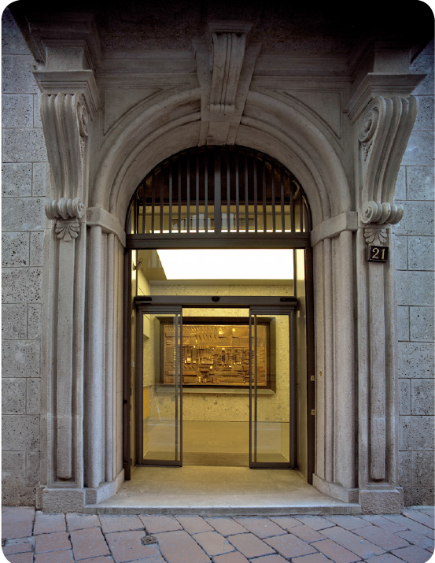
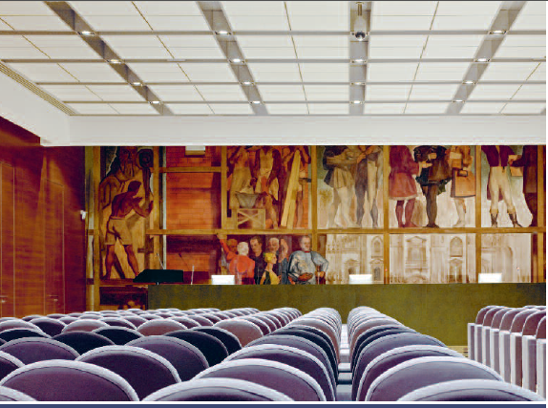
Assimpredil Ance
Matteo Baroni
Notes:
ASSIMPREDIL ANCE is the Association of complementary and construction companies in the districts of Milan, Lodi, Monza and Brianza. The Association is active since 1945 and represents the largest territorial entity of ANCE system, the National Association of Construction Companies.

Slide 3
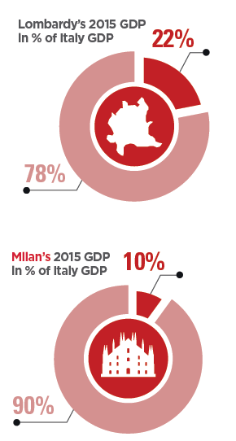
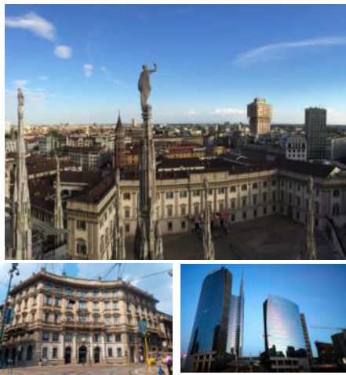
Why Milan
Source: JLL – Why invest in Milan?
Matteo Baroni
Notes:
Milan is the main financial, commercial and industrial center in Italy, continuously attracting investments and new business activities. This is the wealthiest city in the wealthiest region of Italy. Milan is the capital of Lombardy, one of the 20 administrative regions of Italy and accounts for 22% of the country GDP.

Slide 4
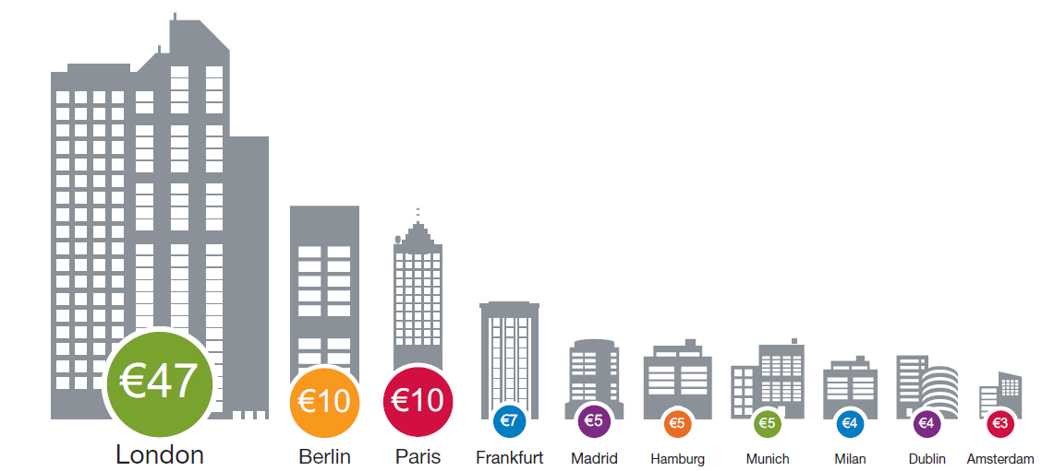
Milan in Europe’s 10 most active markets –
Q4 2014-Q3 2015 (billions)
Source: PWC - Emerging Trends in Real Estate Europe 2016
Matteo Baroni
Notes:
According to the 2016 edition of Emerging Trends in Real Estate in Europe by PWC, Milan was the eighth most active real estate market in Europe , with € 4billion invested between Q4 2014 and Q3 2015.

Slide 5
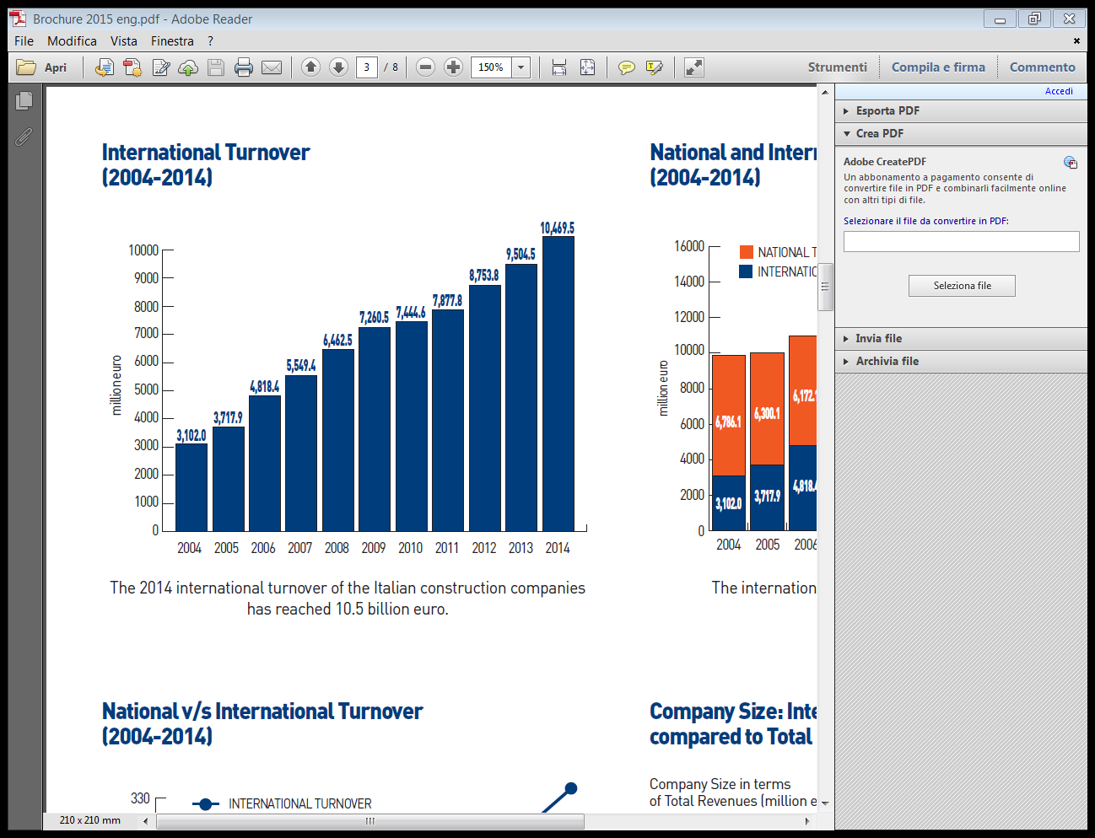
Italian entreprises abroad
Source: ANCE, SURVEY 2015 – The Italian construction companies in the world
Matteo Baroni
Notes:
The 2014 international turnover of the Italian construction companies has reached 10.5 billion euro.

Slide 6
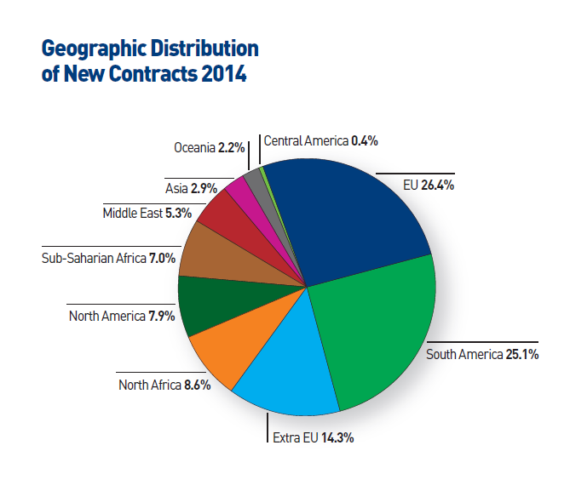
Italian entreprises abroad
Source: ANCE, SURVEY 2015 – The Italian construction companies in the world
Matteo Baroni
Notes:
New contracts signed in 2014 are concentrated in Europe and South America.

Slide 7
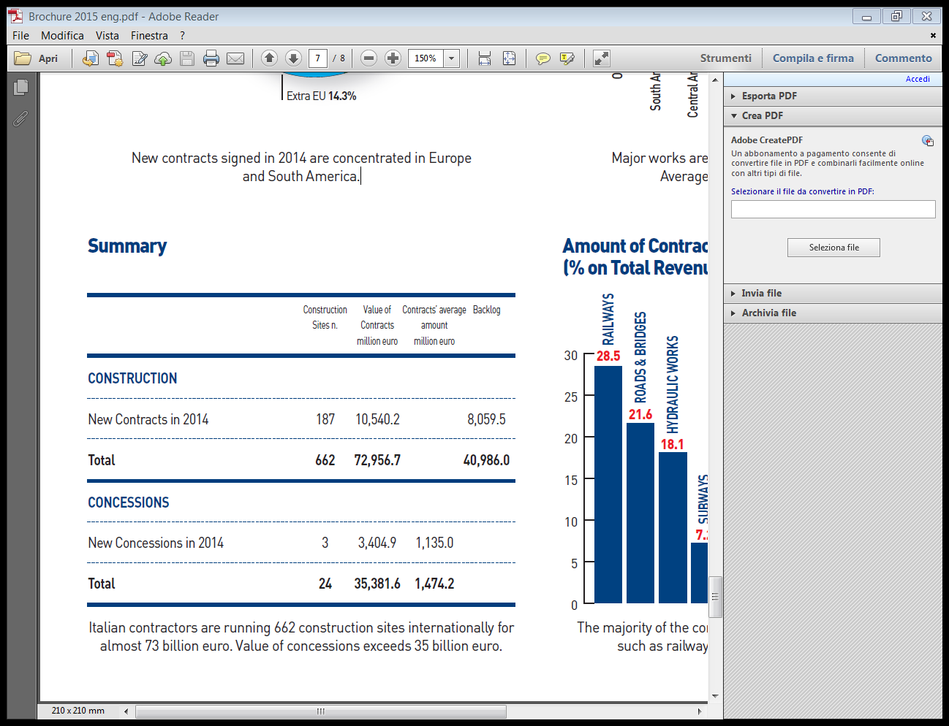
Italian entreprises abroad
Source: ANCE, SURVEY 2015 – The Italian construction companies in the world
Matteo Baroni
Notes:
Italian contractors are running 662 construction sites internationally for almost 73 billion euro. Value of concessions exceeds 35 billion euro.

Slide 8
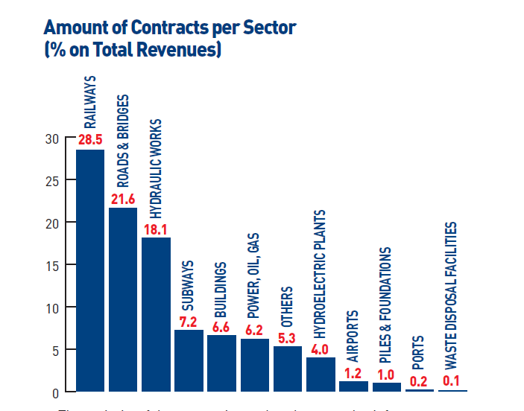
Italian entreprises abroad
Source: ANCE, SURVEY 2015 – The Italian construction companies in the world
Matteo Baroni
Notes:
The majority of the companies undertakes complex infrastructures such as railways, roads, bridges and hydraulic works.

Slide 9
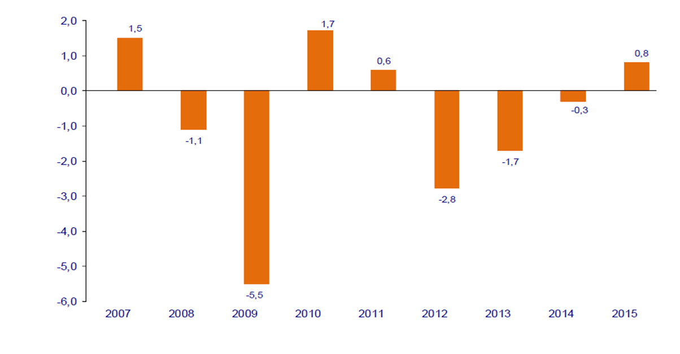
GDP - Var % vs the prevoius year
Source: Processing by ANCE based on ISTAT figures
Matteo Baroni
Notes:
The Italian economy remains weak but in 2015 GDP registered a growth of 0.8% that stops a consecutive three years decline.

Slide 10
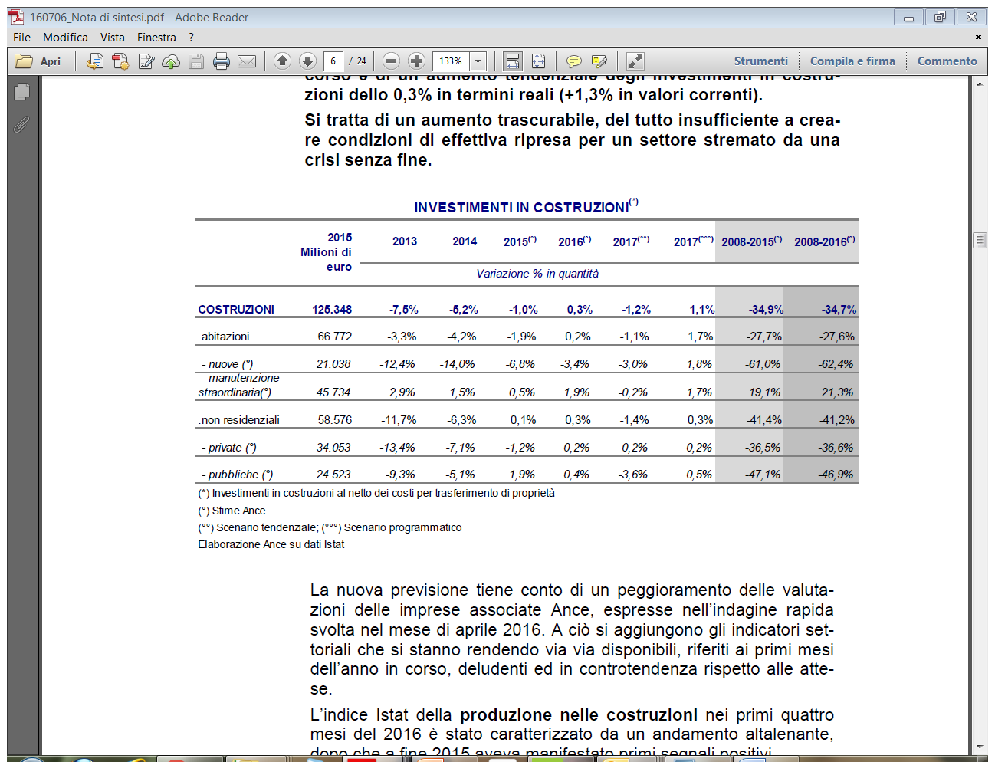
Housing market
Source: Processing by ANCE based on ISTAT figures
Matteo Baroni
Notes:
Housing market. New production still in severe crisis in 2014 and 2015, while incentives have led the growth in renovation.

Slide 11
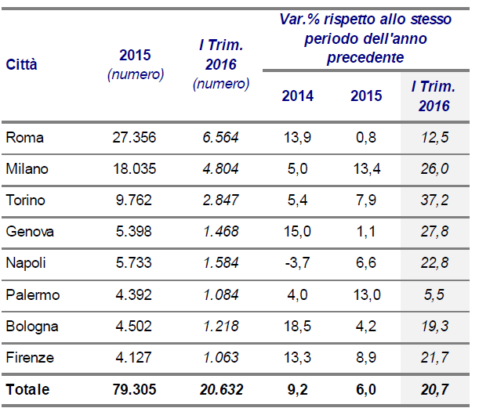
Residential trading
Source: Processing by ANCE based on Agenzia delle Entrate figures
Matteo Baroni
Notes:
Big cities have registered a positive trend in residential transactions. Milan has performed a +26% in Q1 2016

Slide 12
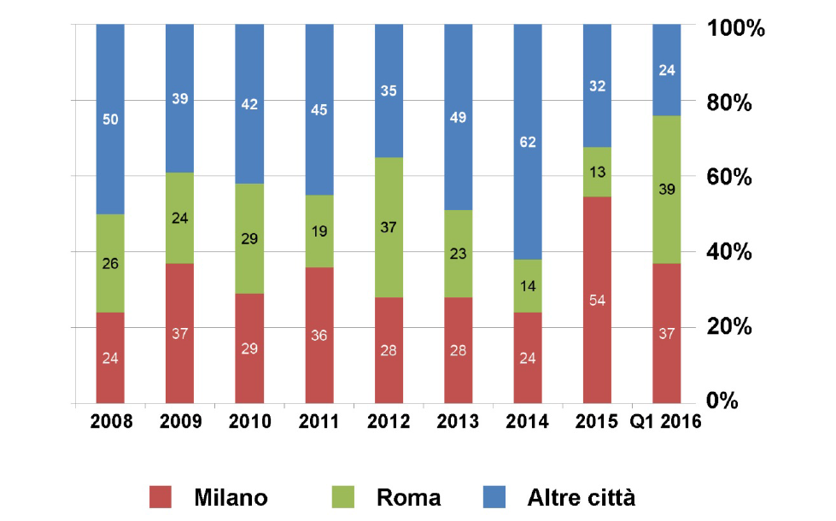
Corporate market - Investments by location
Milan
Rome
Other cities
Source: Processing by Nomisma based on Nomisma, BNP Paribas and CBRE figures
Matteo Baroni
Notes:
Overseas investors have poured important investments in the office market, especially in Milan

Slide 13
Bedankt voor uw aandacht!
Nome relatore
Notes:
Thank you for your attention!

